Slide 1

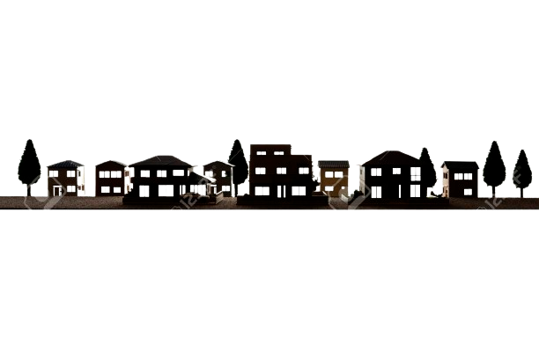
House Price Prediction
Aligarh College of Engineering and Technology
(APPROVED BY A.I.C.T.E & AFFILIATED TO AKTU, LUCKNOW)
Session: 2020 - 2024
A Project Report on
Exploring the House Prices in Bengaluru
Team Members :
Anurag Gupta (2001090100004)
Arpit Kumar Nauhwara (2001090100006)
Hemant Sharma (2001090100021)
Submitted To
Dr. Anand Sharma Mr. Rohit Yadav
HOD of CSE Project Incharge/Guide

Slide 2
PROBLEM STATEMENT,
• It is very difficult to search house at places like Bengaluru. Even if you find a house it is very difficult to get a perfect price for the same.
• To overcome such problem Machine Learning technique can be used.
• Using Data Analysis and Machine Learning Technique it will be easy to know the price of house based on the area available, number of bedrooms, facilities available.

Slide 3
OBJECTIVE,
The objective of the House Price Prediction Project is to develop an accurate machine learning model forecasting residential property prices in Bangalore. It aims to provide precise predictions, offer insights into market dynamics, ensure transparency, generalize well to unseen data, and empower users with a user-friendly interface. By achieving these goals, the project seeks to contribute to a transparent and informed real estate market, enabling stakeholders to make confident decisions in property transactions.

Slide 4
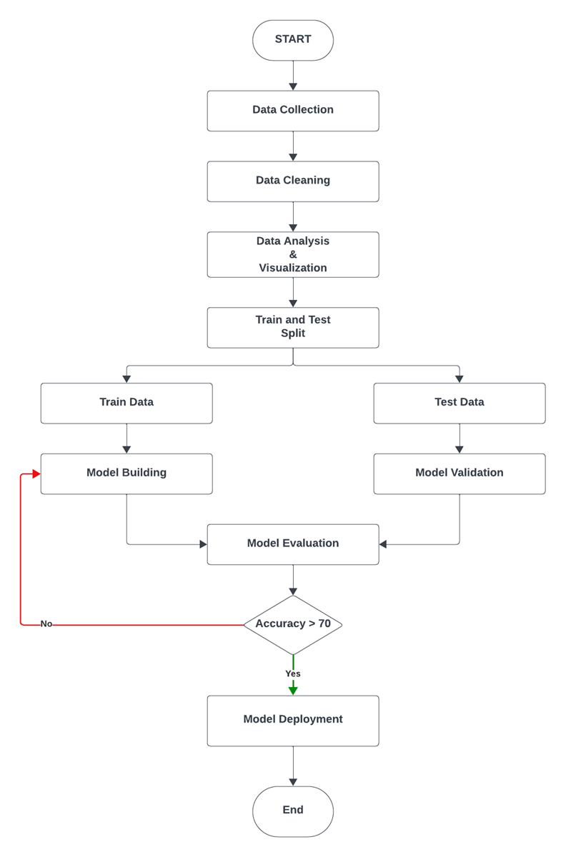
WORKFLOW,

Slide 5
TOOLS AND TECHNOLOGIES,
Python.
Numpy and Pandas for data cleaning.
Matplotlib and Seaborn for data visualization.
Sklearn for model building.
Google Collab, Jupyter notebook, and visual studio code as IDE.
Python, flask for http server.
HTML/CSS for UI.

Slide 6
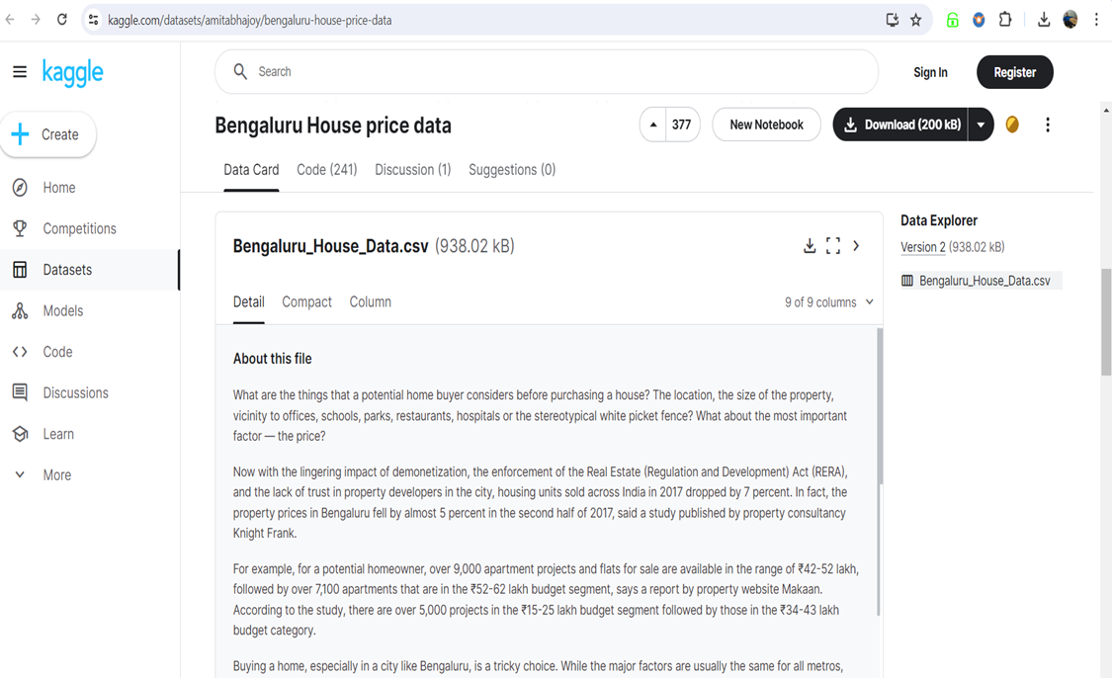
DATA COLLECTION,
.

Slide 7
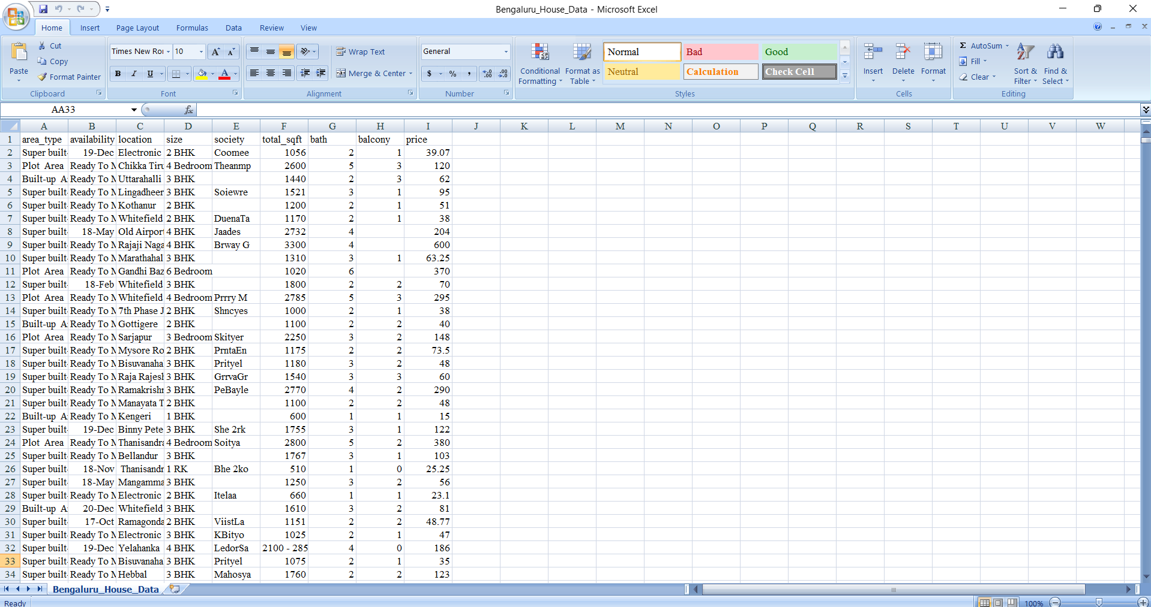
DATASET OVERVIEW,
.

Slide 8
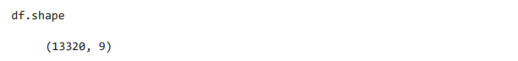
ABOUT DATASET,
Area type : Description of the area.
Availability : when it is ready.
Location : Where it is located in Bengaluru.
Size : BHK or Bedrooms.
Society : To which society it belongs.
Total sqft : Size of the property in sq.ft.
Bath : No. of Bathrooms.
Balcony : No. of the Balcony.
Price : Value of the property in lakhs (Indian Rupee - ₹ ).
Now Check the shape of Dataset,

Slide 9
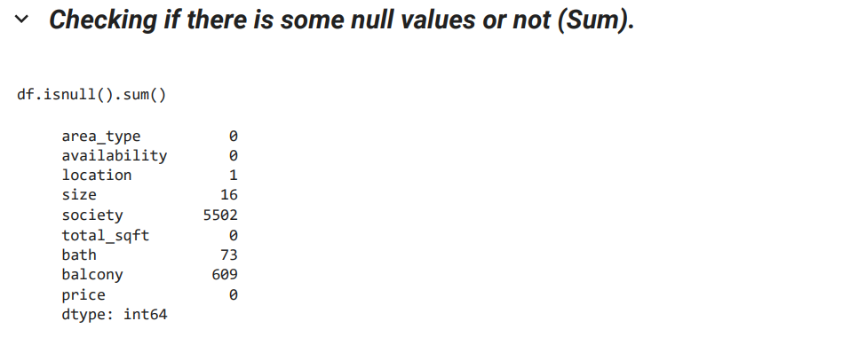
DATA CLEANING AND PREPROCESSING,
Data cleaning and preprocessing involves preparing raw data for analysis by removing errors, and irrelevant information.
It includes tasks like handling missing values.

Slide 10
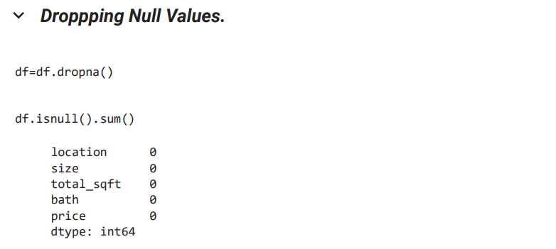
DATA CLEANING AND PREPROCESSING,
After Checking Null Value, we drop Null value by using command “df.dropna()”.

Slide 11
DATA VISUALIZATION,
Data visualization is about presenting data in graphical or visual formats like,
Charts,
Graphs,
Maps.
It helps make complex data easier to understand, allowing us to spot patterns, trends, and insights more quickly and effectively.

Slide 12
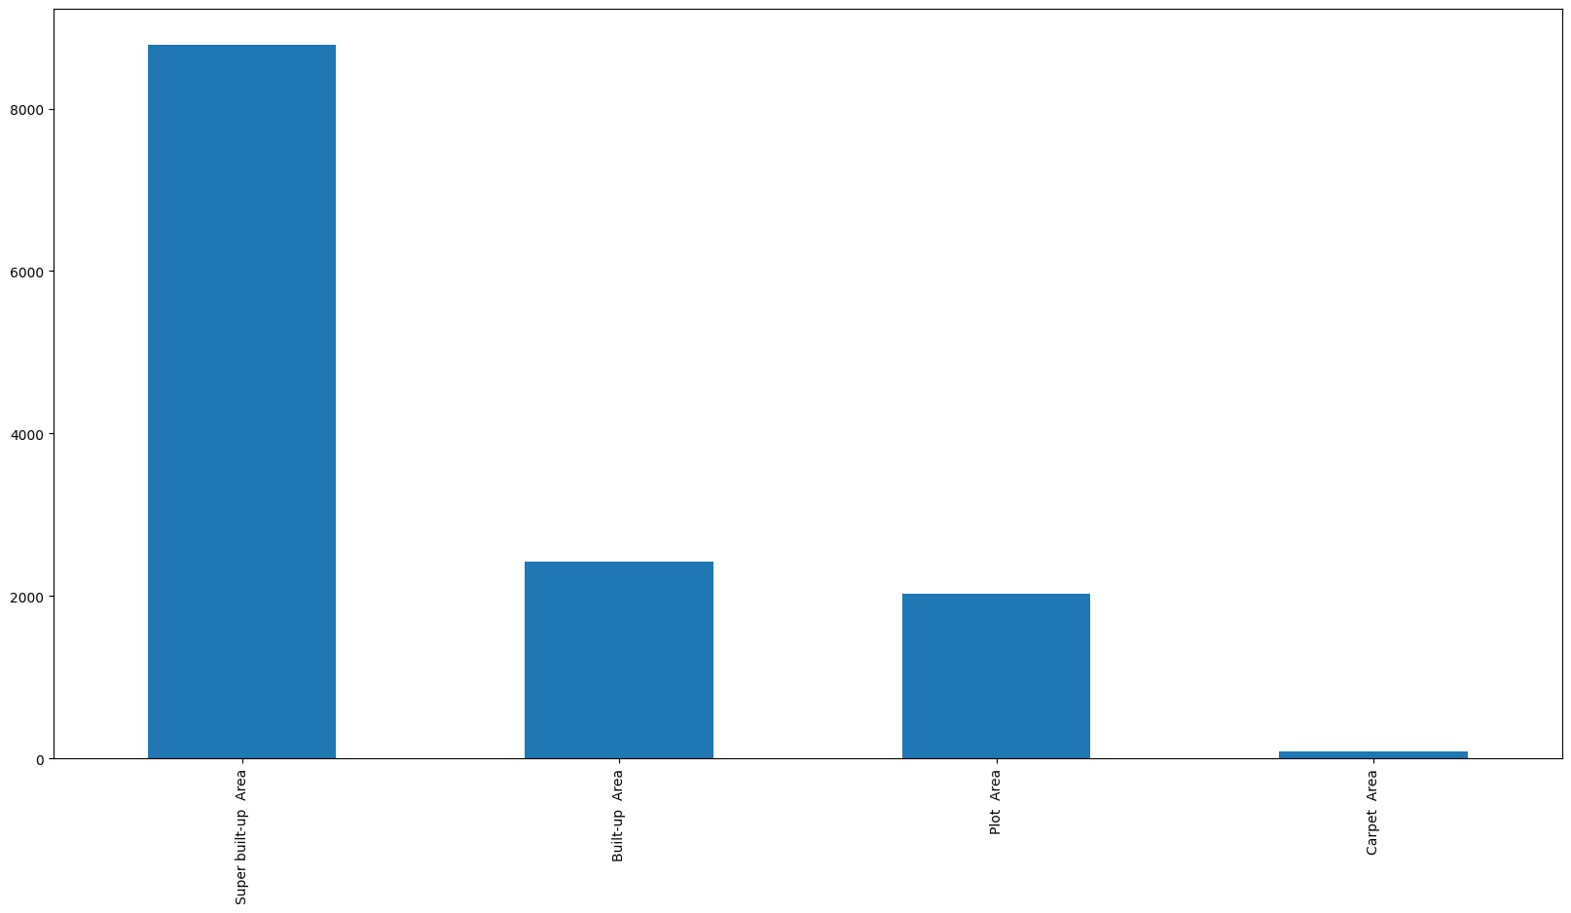
DATA VISUALIZATION,
1. BAR CHART : In the given Bar Chart, it shows that which area type have how much Property.

Slide 13
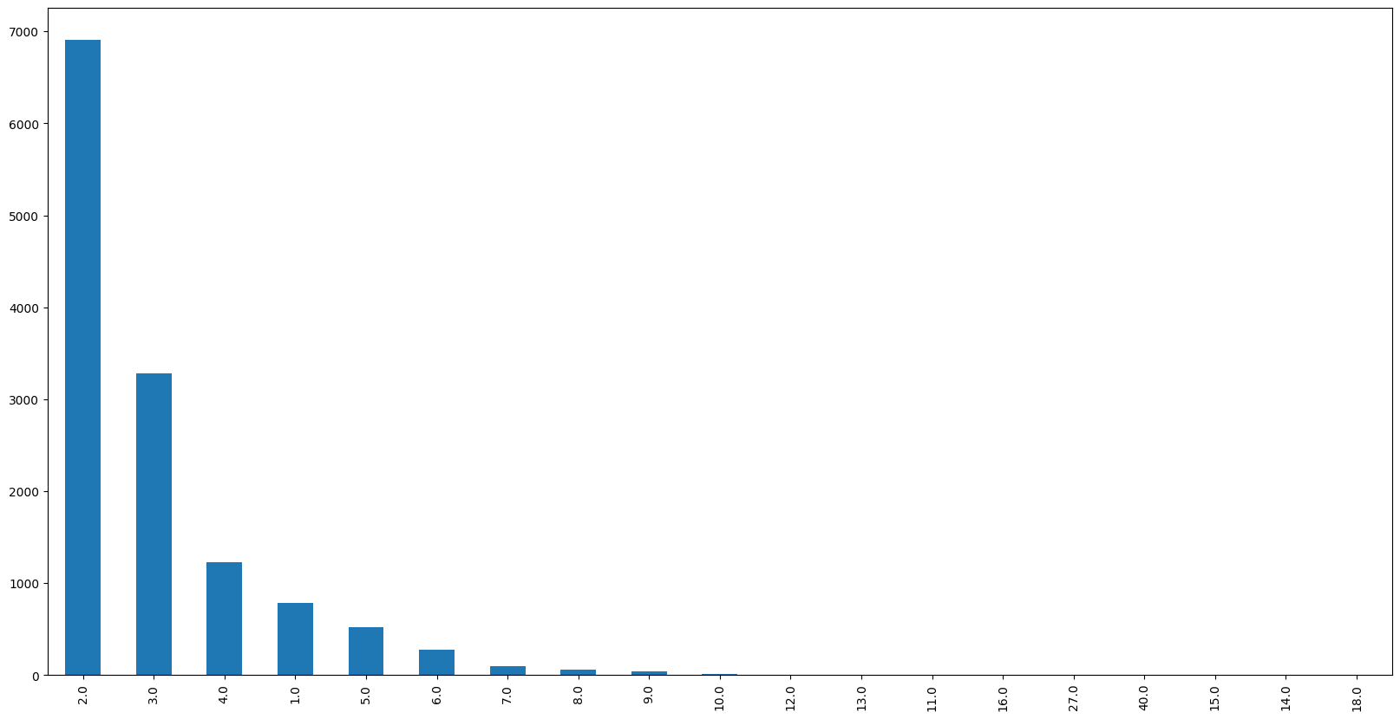
DATA VISUALIZATION,
2. BAR CHART : In the given Bar Chart, it shows that how much property have how much bathrooms.

Slide 14
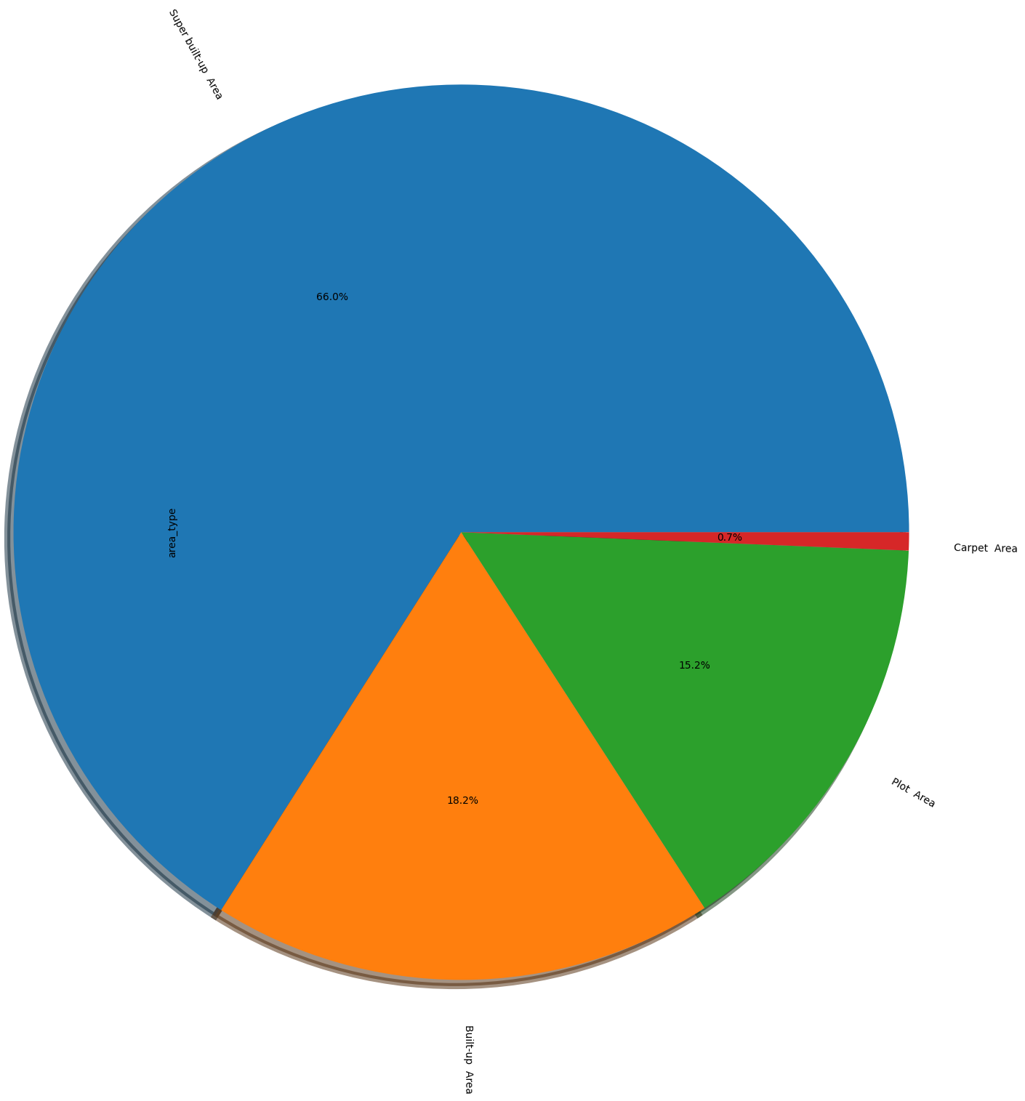
DATA VISUALIZATION,
3. PIE CHART : In the given Pie Chart, it shows that which area type have how much Property in Percentage (%).
Area Type in %.
Super built-up area. (66.6%)
Built-up Area.
(18.2%)
Plot Area. (15.2%)
Carpet Area. (0.7%)

Slide 15
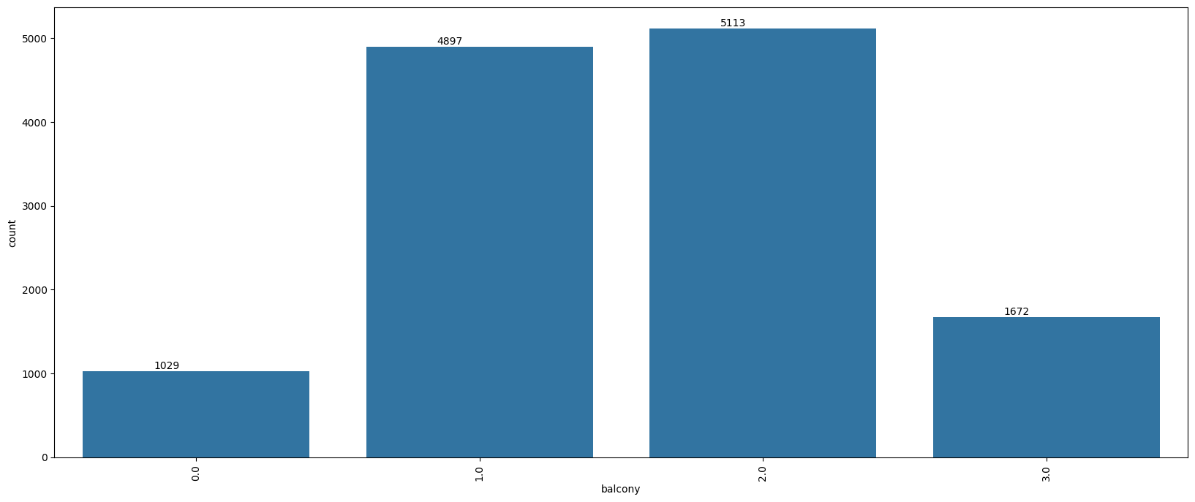
DATA VISUALIZATION,
4. BAR CHART : In the given Bar Chart, it shows that how many Property have how much balcony.

Slide 16
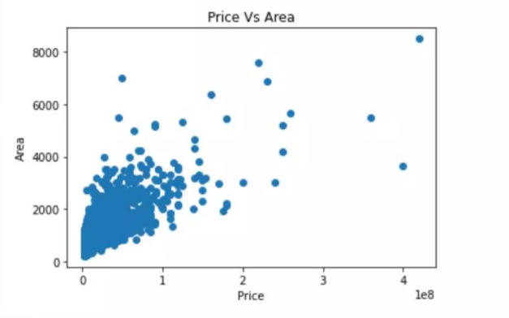
DATA VISUALIZATION,
5. SCATTER PLOT : In the given Scatter plot it shows that as the 'Price' of house increases with increase in 'Area' of house.

Slide 17
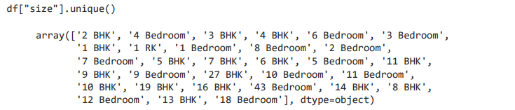
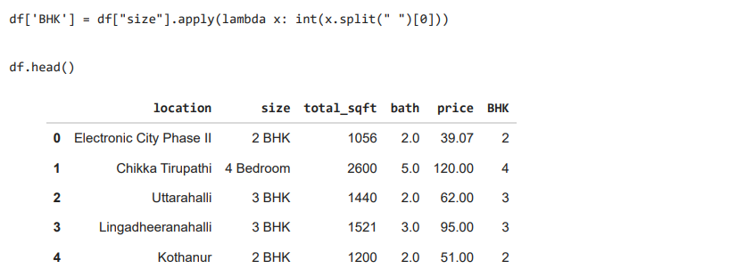
FEATURE ENGINEERING,
Firstly We get a Unique Function from Size,
From the above we can clearly see that Bedroom is represented with 2 different methods. One is BHK and the other one is Bedroom. So we are making a new column called BHK and we are discarding all the units (like BHK, Bedroom).

Slide 18
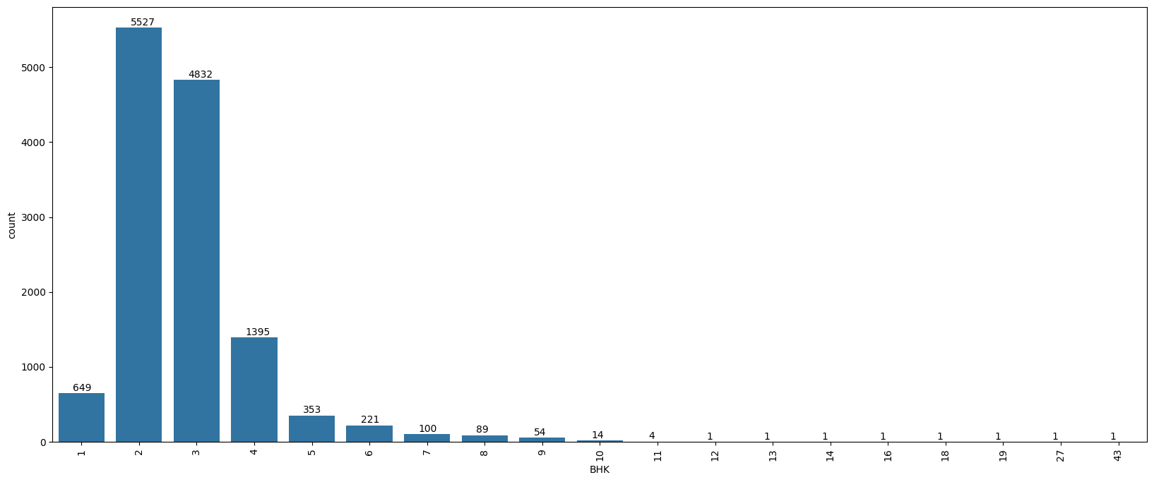
FEATURE ENGINEERING,
Secondly we created a Bar Chart, which shows how much property have how much BHK.

Slide 19
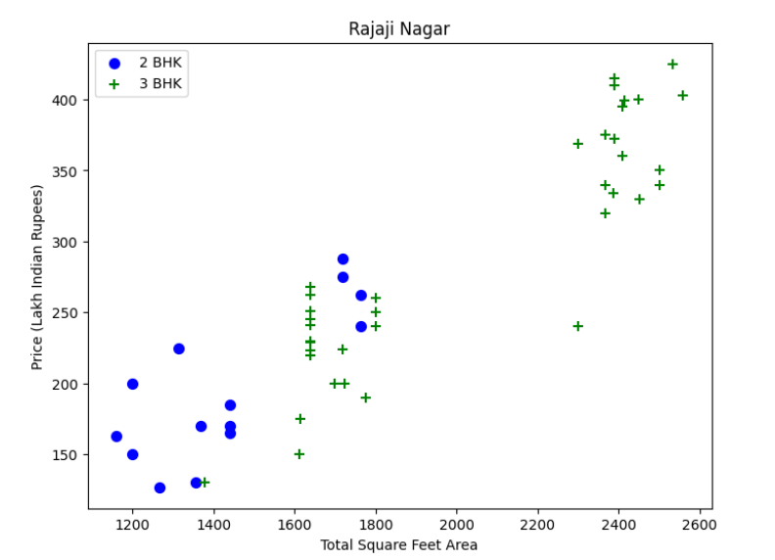
FEATURE ENGINEERING,
Now, we Plotting the Scatter Chart for 2 BHK and 3 BHK properties.

Slide 20
.
Aligarh College of Engineering and Technology
(APPROVED BY A.I.C.T.E & AFFILIATED TO AKTU, LUCKNOW)
THANK YOU
Hemant Sharma
(2001090100021)

Slide 21
MACHINE LEARNING
MODEL
DEVELOPMENT,

Slide 22
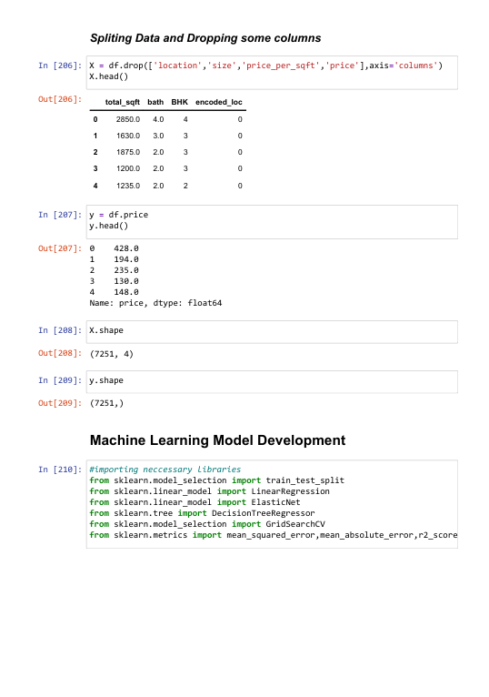
SPLITTING DATA,
Splitting the data for training and testing of model.
Independent data as X
Dependent data s Y

Slide 23
IMPORTING LIBRARIES,

Slide 24
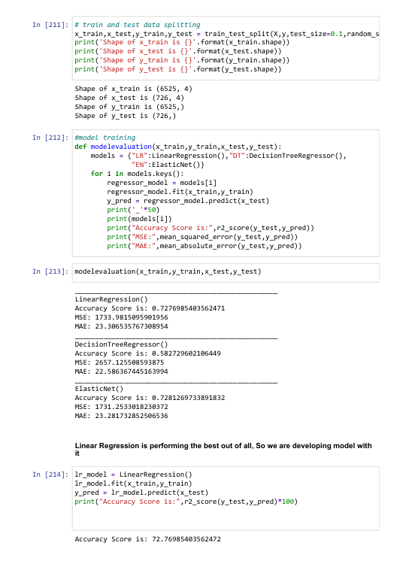
MODEL DEVELOPMENT,
Building the ML Model by considering various algorithms and out of which we are selecting the best model.
Linear Regression performing best of all model with Accuracy Score more than 70%

Slide 25
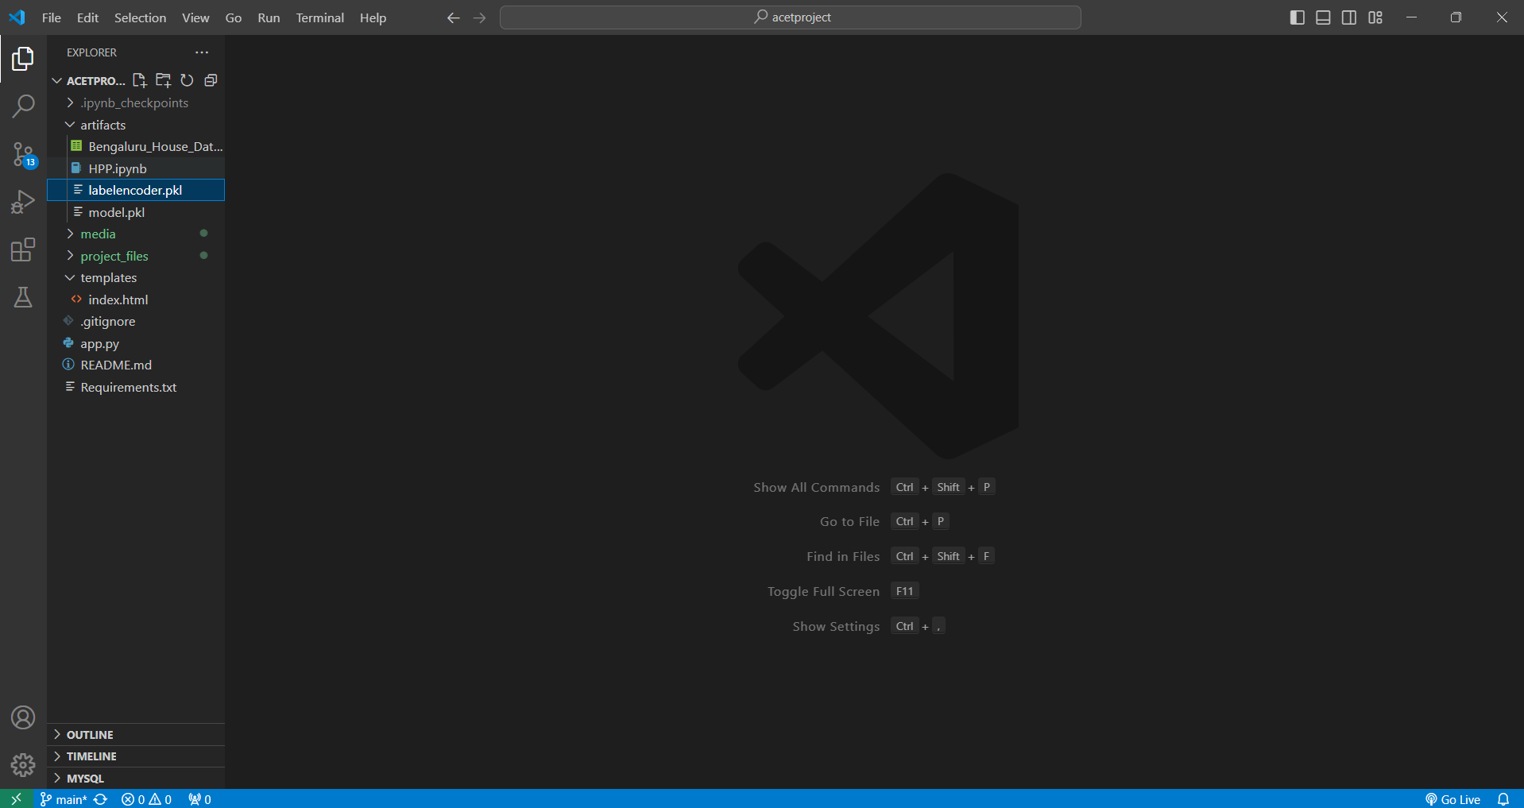
EXPORTING MODEL,

Slide 26
MODEL DEPLOYMENT,

Slide 27
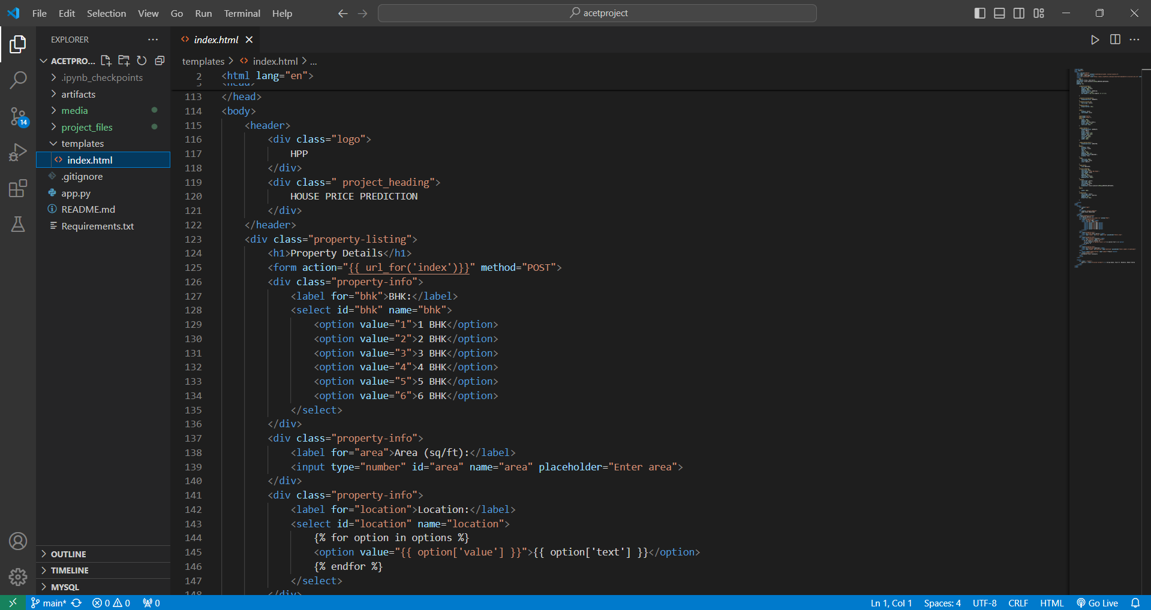
FRONTEND DEVELOPMENT,
HTML:

Slide 28
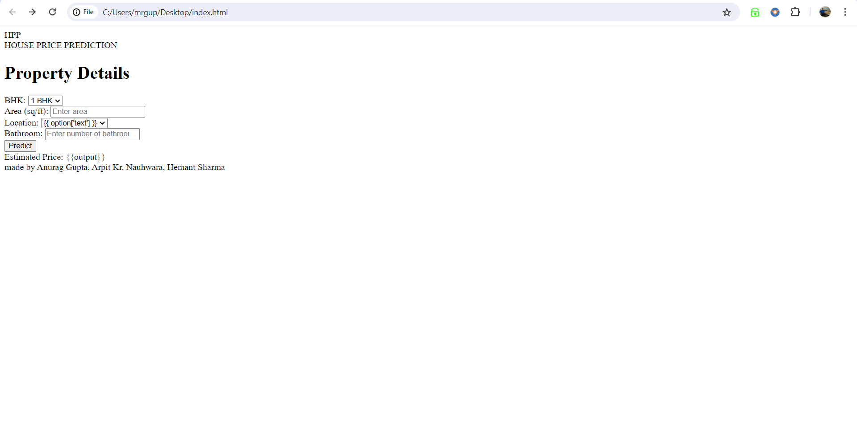
RAW WEBSITE,

Slide 29
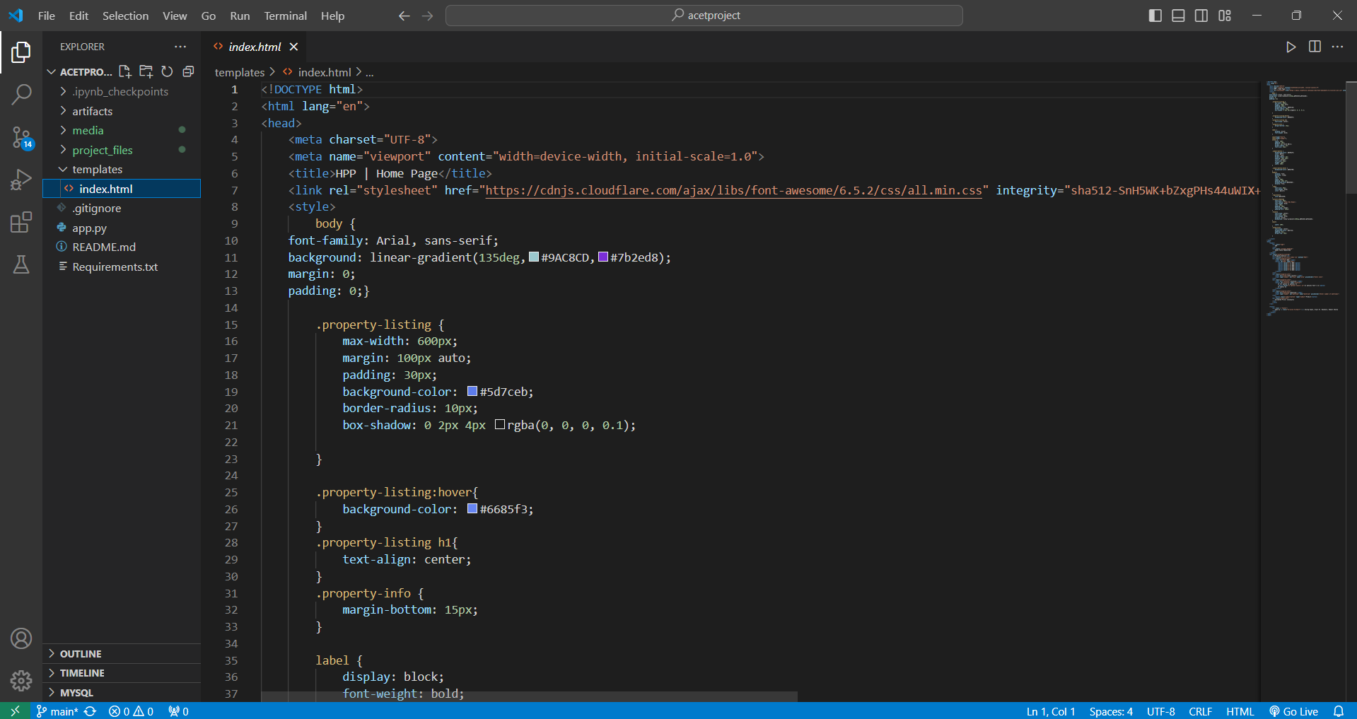
FRONTEND DEVELOPMENT,
2. CSS

Slide 30
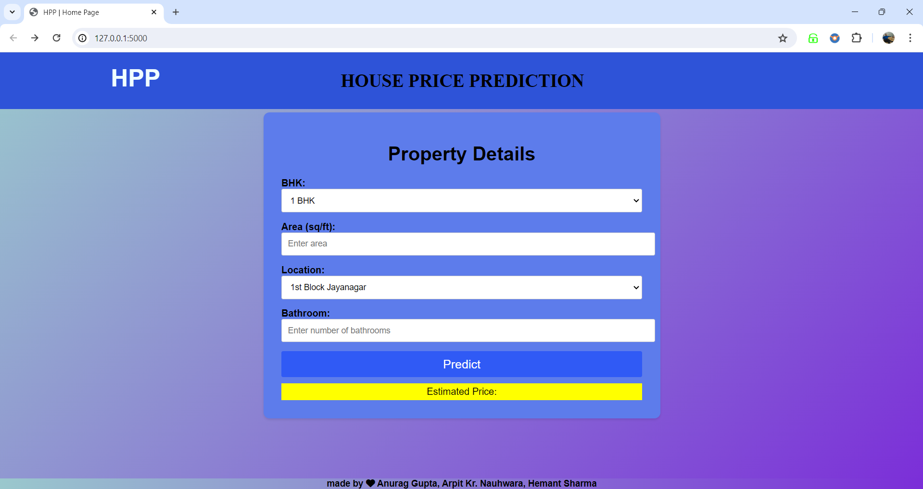

Slide 31
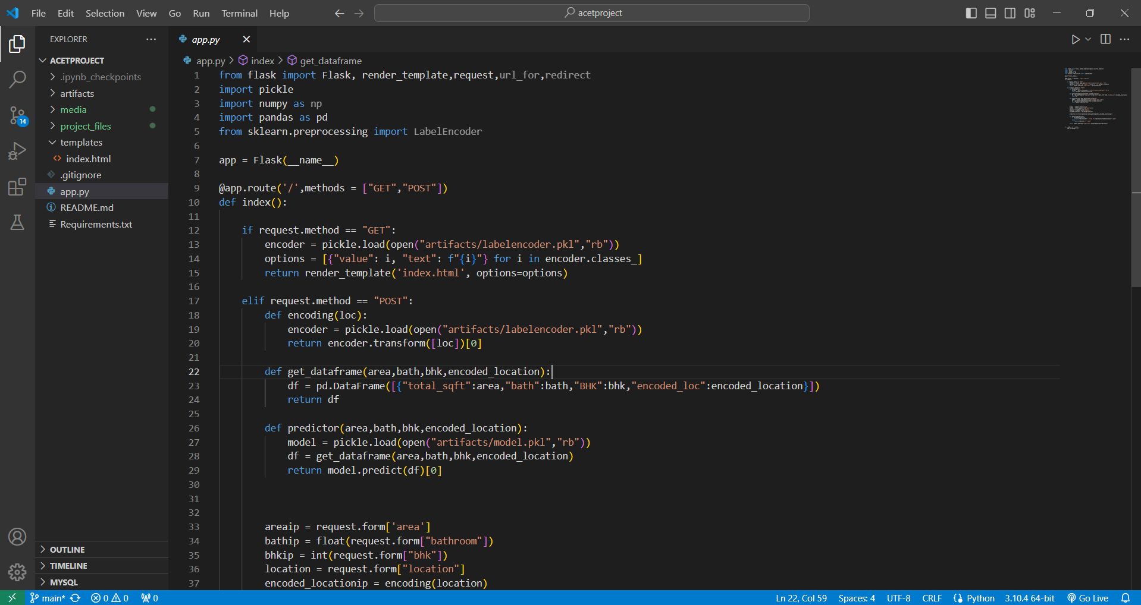
BACKEND DEVELOPMENT,
FLASK

Slide 32
TUTORIAL,

Slide 33
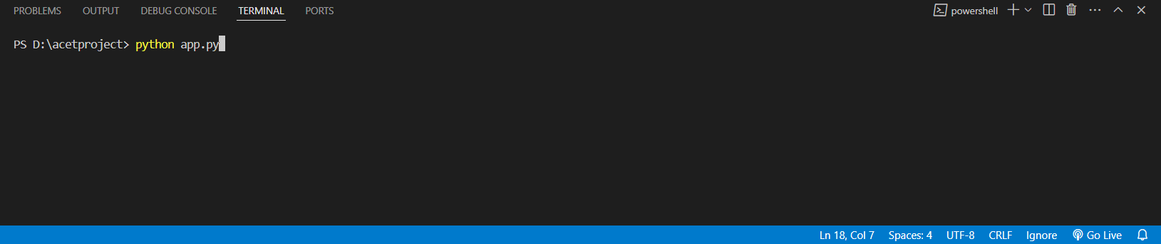
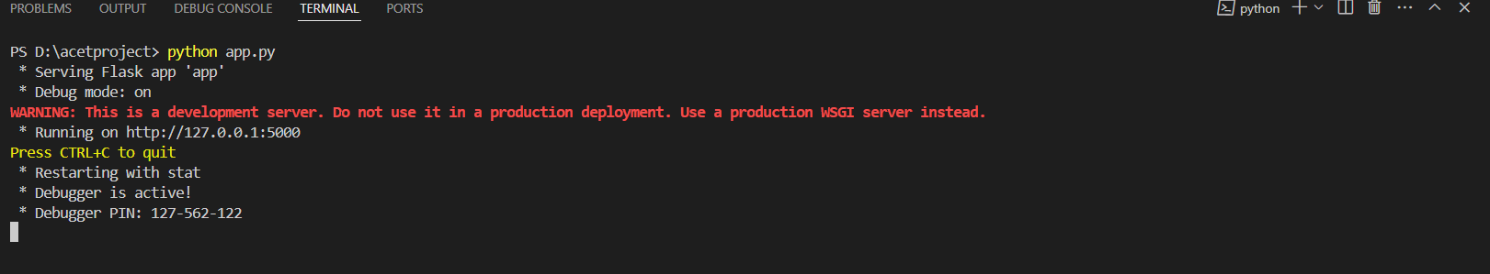
COMMAND TO RUN

Slide 34
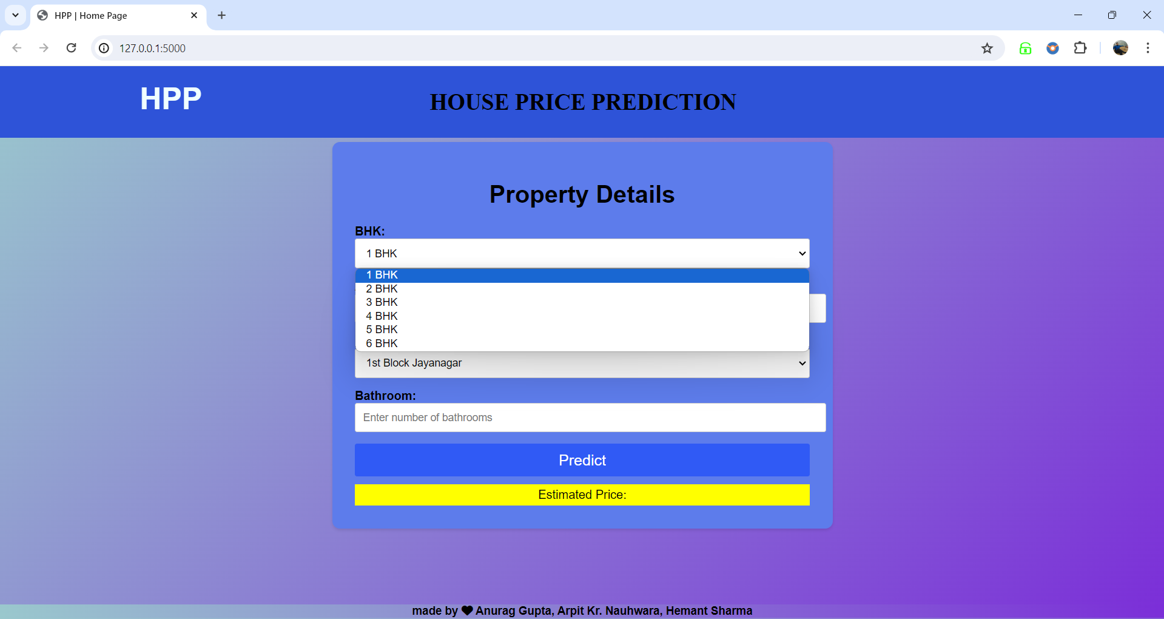

Slide 35
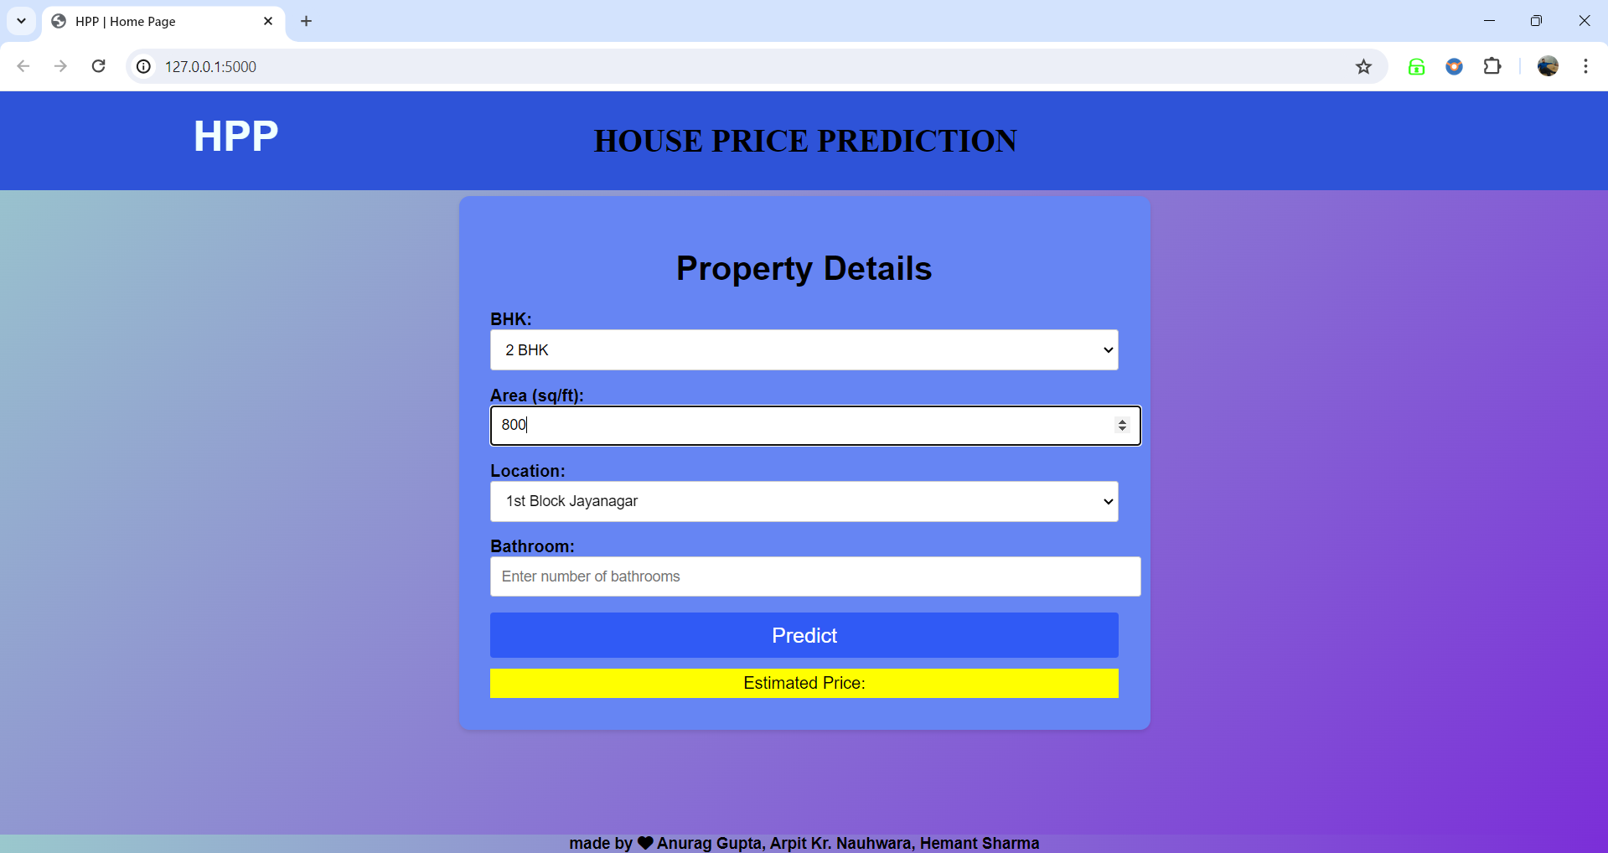

Slide 36
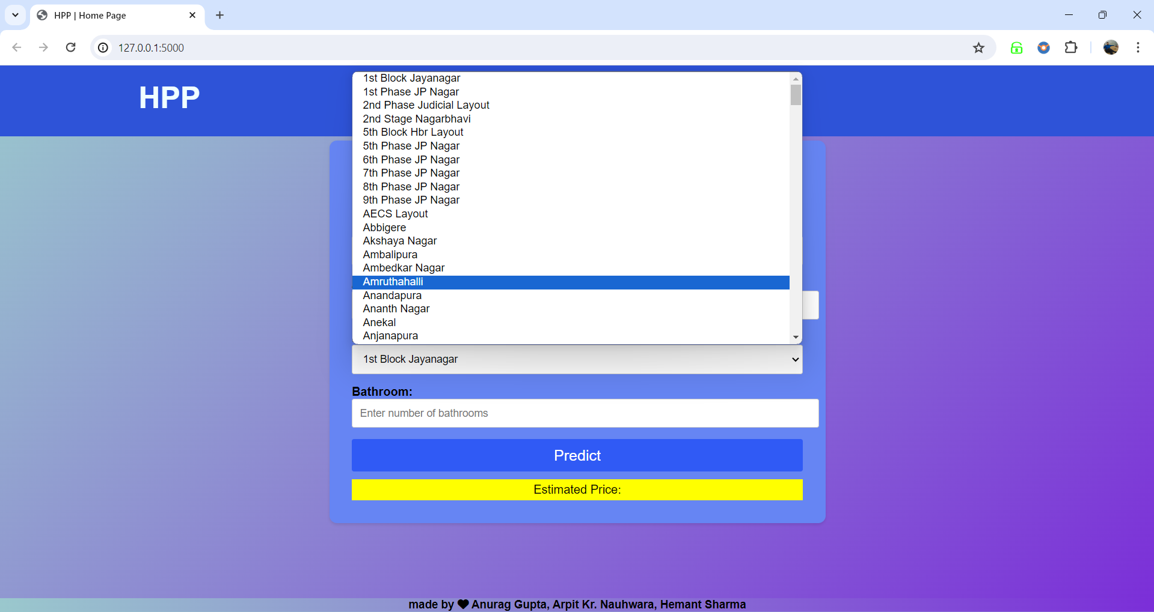

Slide 37
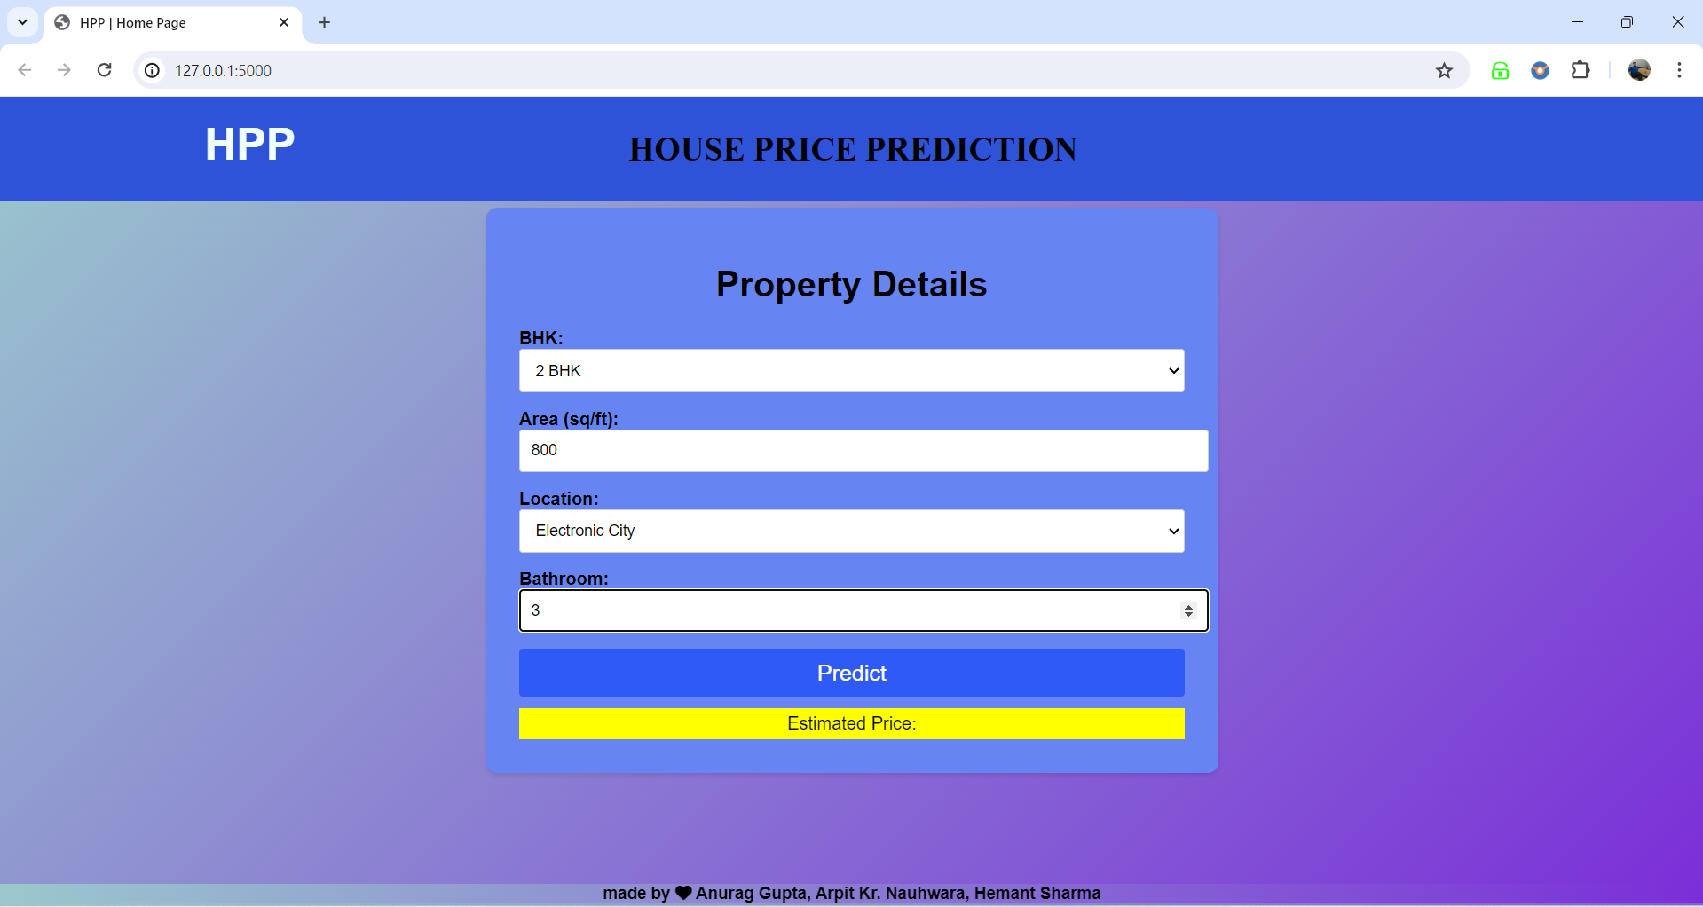

Slide 38
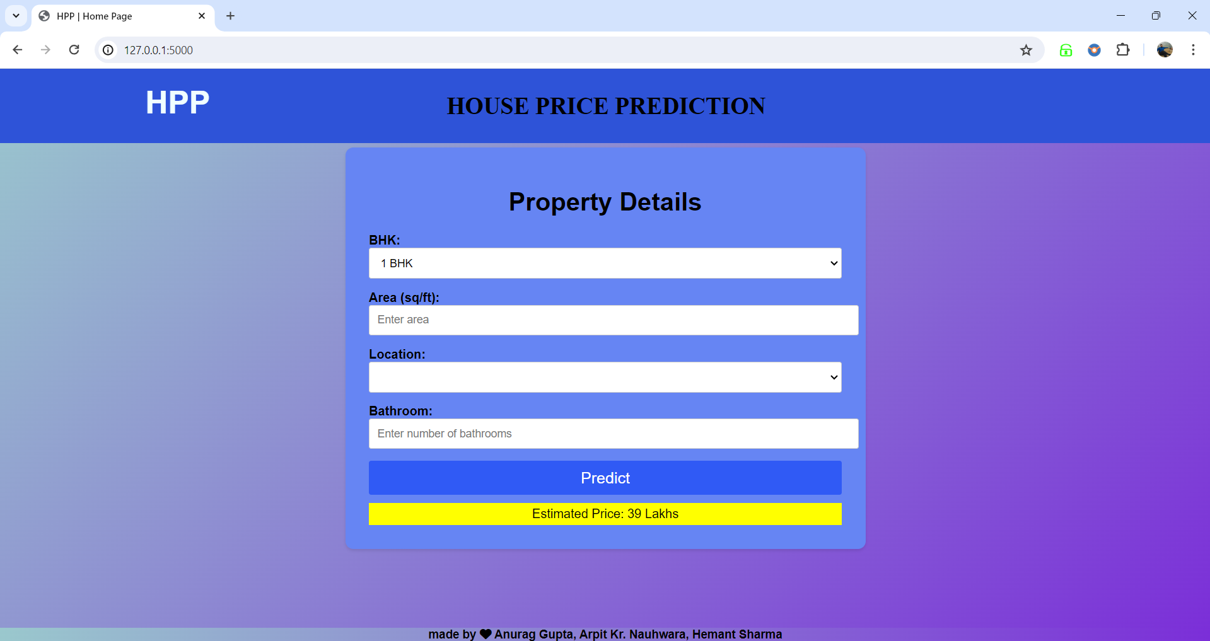

Slide 39
THANKYOU!
(APPROVED BY A.I.C.T.E & AFFILIATED TO AKTU, LUCKNOW)
Anurag Gupta (2001090100004)
Arpit Kumar Nauhwara (2001090100006)
Hemant Sharma (2001090100021)

